Slide 1
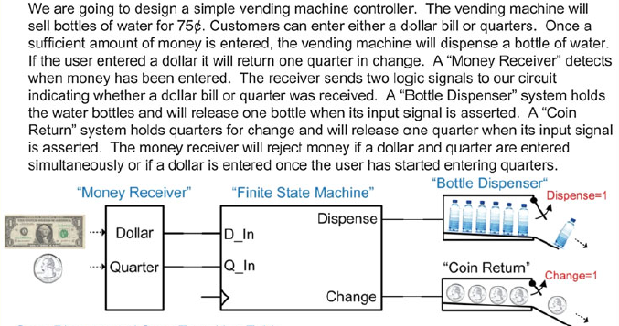
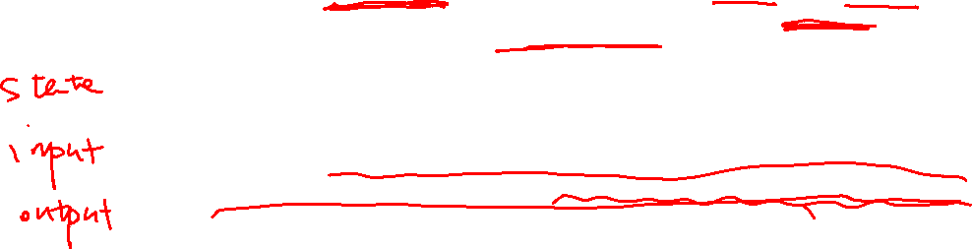
Lab. Design of the Vending machine

Slide 2
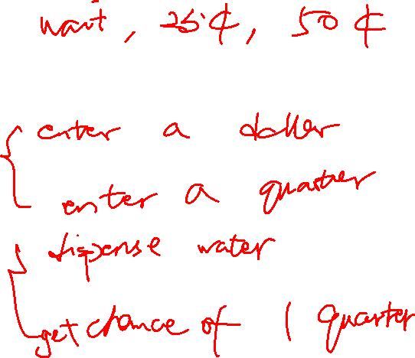
Lab. Design of the Vending machine
State:
Input:
Output:

Slide 3
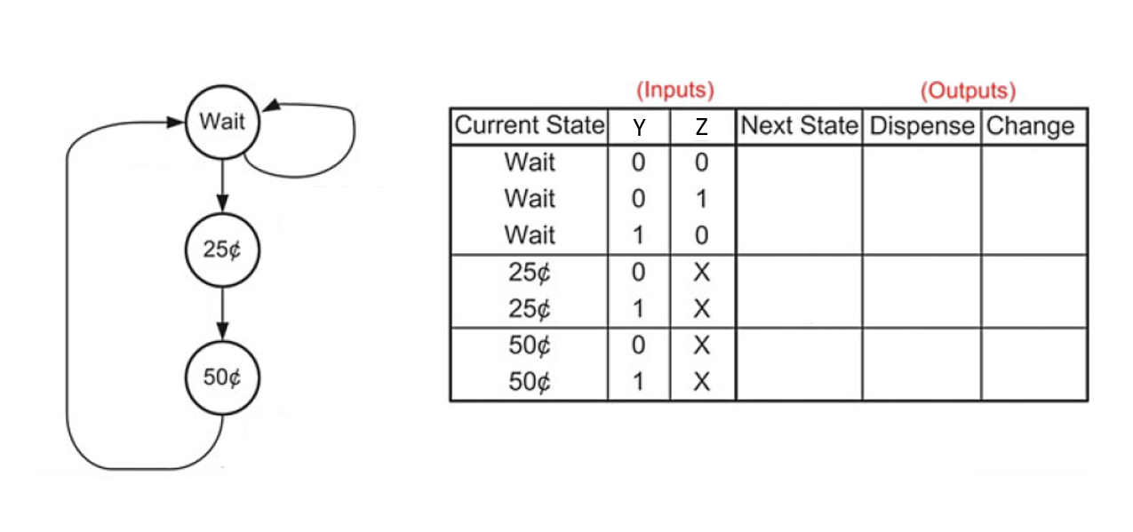
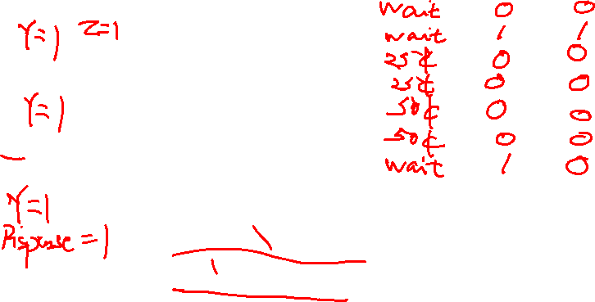
Lab. Design of the Vending machine
Y: insert a quarter
Z: insert a dollar

Slide 4
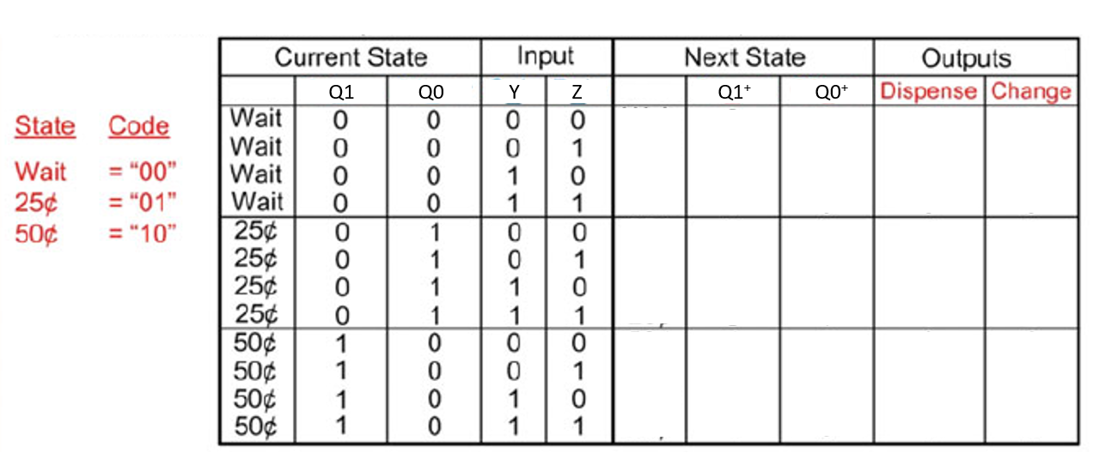
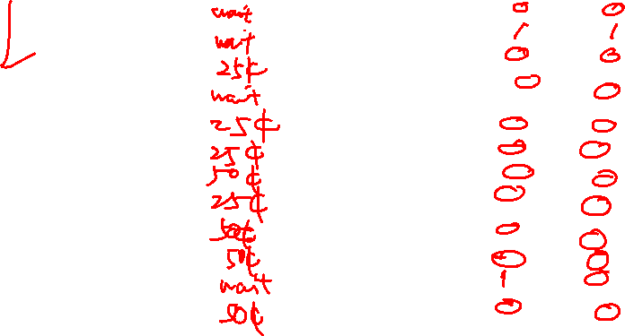
Lab. Design of the Vending machine

Slide 5
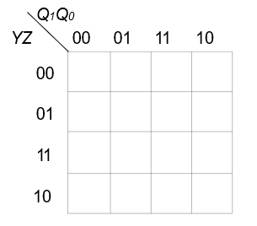
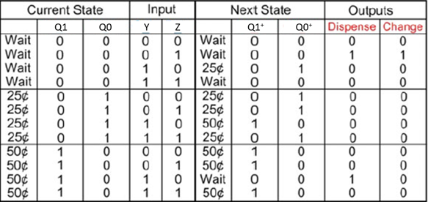
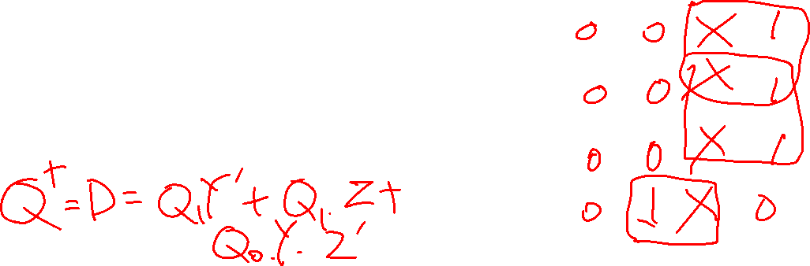
Lab. Design of the Vending machine
K-map for Q1⁺

Slide 6
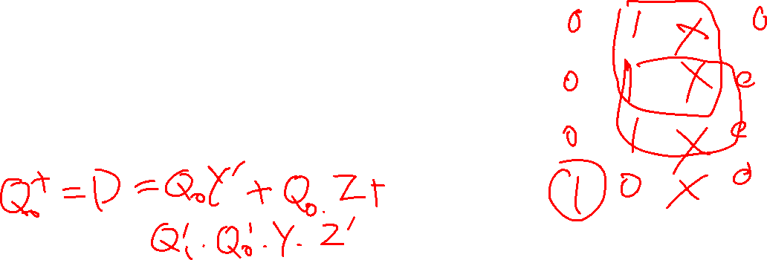
Lab. Design of the Vending machine
K-map for Q0⁺

Slide 7
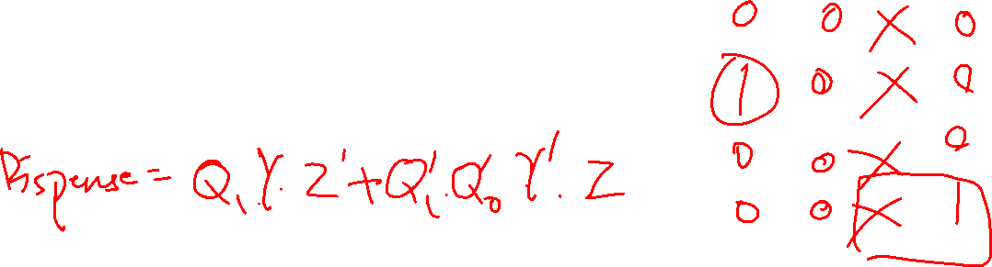
Lab. Design of the Vending machine
K-map for Dispense

Slide 8
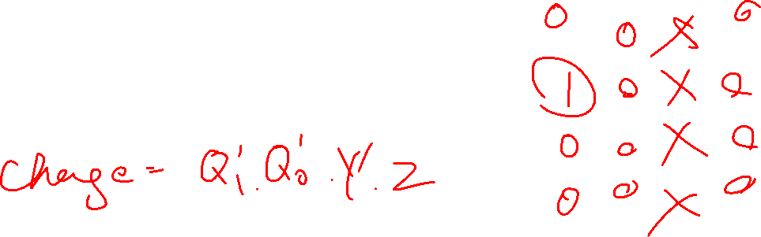
Lab. Design of the Vending machine
K-map for Change

Slide 9
Lab. Design of the Vending machine
Draw the circuit diagram
Implement the circuit in Simulink
^{1. Pulse wave generator for Y:}
sample based, amplitude=1, period=10, pulse width=7, phase delay=0, sample time=1
^{2. Pulse wave generator for Z:}
sample based, amplitude=1, period=10, pulse width=6, phase delay=10, sample time=1
3. Pulse wave generator for clock signal:
sample based, amplitude=1, period=2, pulse width=1, phase delay=1, sample time=1
4. Observe the result on a scope:
Scope has 7 input ports for: clock signal, Y, Z, Q1+, Q0+, change, dispense
5. Simulation time duration: 7s

